Slide 1

How to help your child
Using Phonemic Awareness &
Decoding Strategies

Slide 2


The 15 minutes you spend reading with your child will be the
most important 15 minutes of your day.

Slide 3
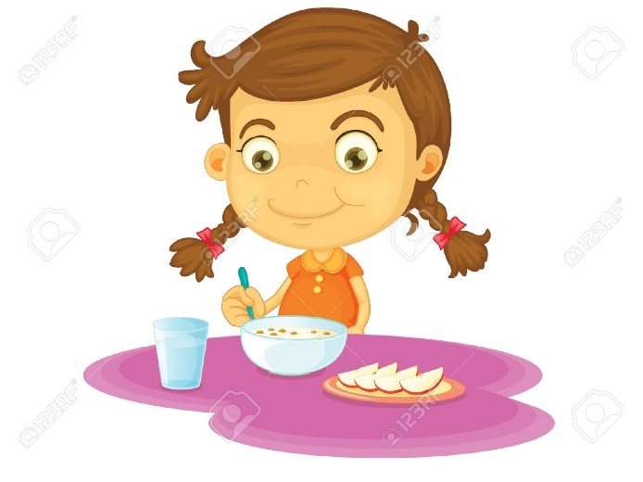
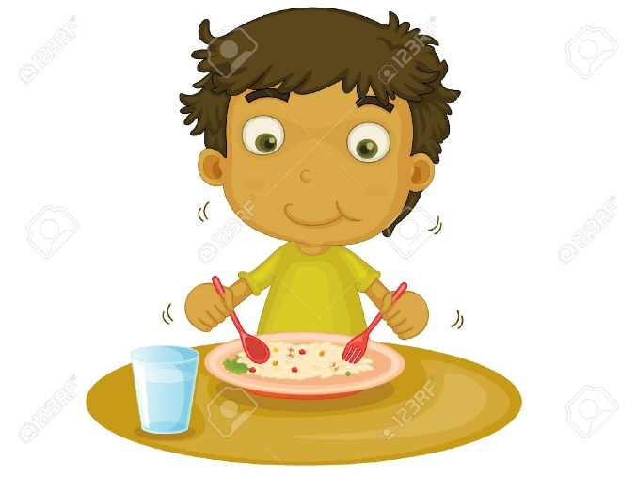
Start
Home Learning after
your child has had a break.

Slide 4
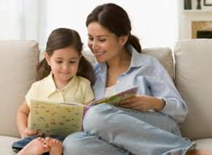
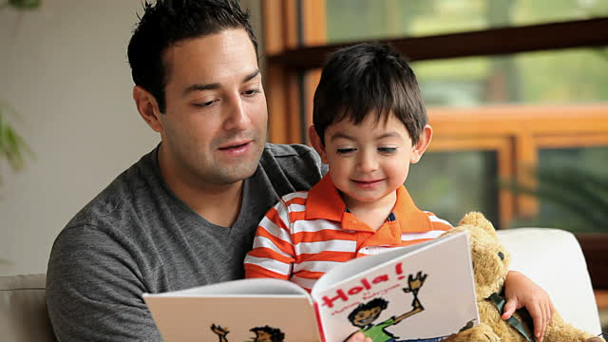
Make sure you can provide 10 - 15 minutes of uninterrupted time.

Slide 5

Listen to your child read the new book independently.
If your child comes across a tricky
word which they are not attempting
to work out independently,
don’t tell them the word.
Encourage them to use a reading strategy.

Slide 6
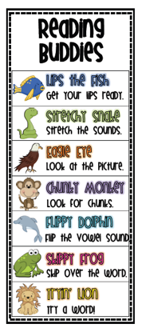
Reading
Strategies
Strategies are things the children can
do to help them work out a word that
they do not recognize automatically.

Slide 7
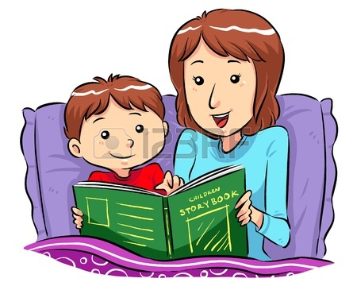

Discuss the book together
.

Slide 8

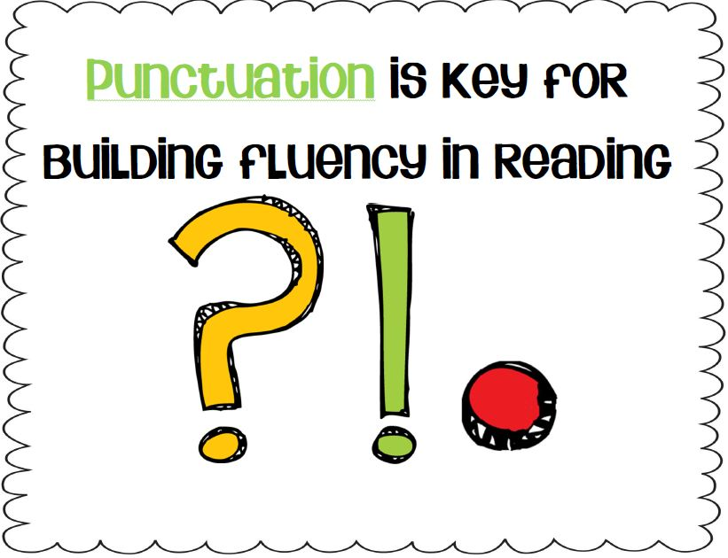

Fluency
Accuracy Rate Expression

Slide 9
Accuracy
Reading is a lot more fun when you are able to understand what you are reading! This is what reading fluency is all about.
Accuracy refers to refers to reading words without mistakes.
To improve your child‘s accuracy, have them listen to themselves read a passage and then discuss it with them. Does it make sense? Is there a different word that might fit better? It is difficult to improve upon something if they don’t recognise what they are doing wrong.

Slide 10
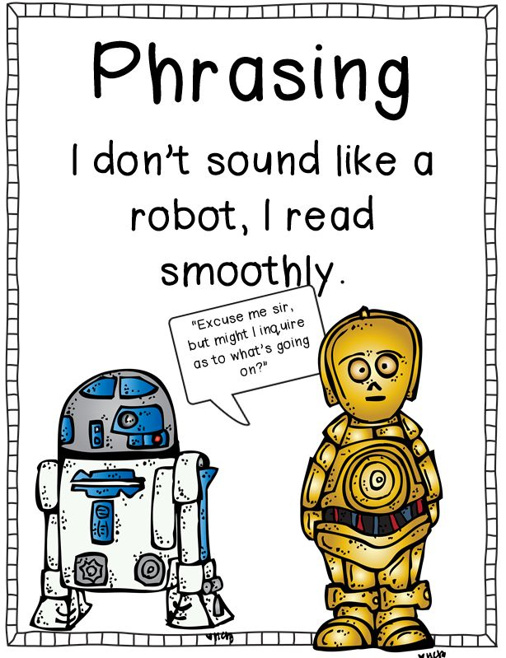
Rate
Rate refers to how quickly a child can read. It has a huge impact on their fluency.
To increase their speed when reading, children need to be able to recognise and decode words effortlessly.
To help you child with their accuracy and speed when reading read to your child to show what fluent reading sounds like. Choose stories and books that will interest them. Read naturally, with the right emotion or tone to match the words you’re reading.

Slide 11
Expression
Expression refers to the ability to change your voice to show feeling when reading.
As you child’s fluency increases, so does their confidence with the text. They begin to give a voice to their character by reading with emotion, excitement, or even sorrow, depending on the character.
It is important to teach children the meaning of punctuation marks and how each sentence is read differently depending on the punctuation mark. When a full stop is at the end of the sentence, your child comes to a complete stop. When a question mark ends the sentence, their voices will generally go up at the end. When an exclamation mark ends the sentence, they need to use a surprised or excited voice.

Slide 12

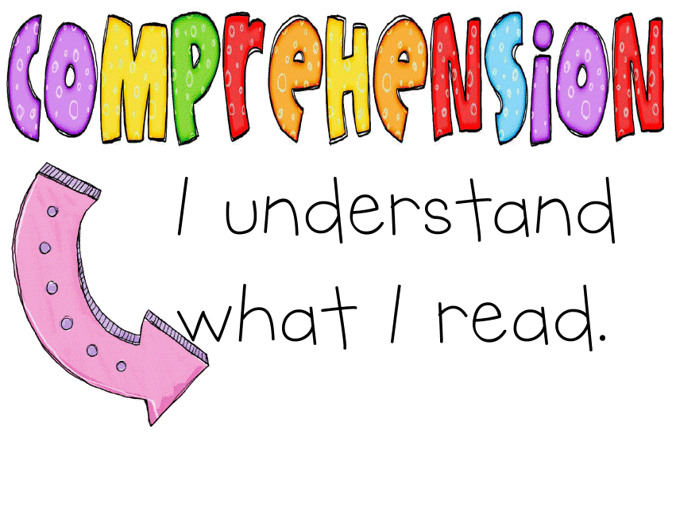
Comprehension
Literal Inferential Evaluative

Slide 13
Literal Comprehension
Literal comprehension involves what the author is actually saying.
Your child needs to understand ideas and information explicitly stated in the reading material.
Therefore literal questions have responses that are directly stated in the text. This includes who, what, where, when, why and how questions.
Some examples of literal questions to ask your child might be:
Who is the main character?
What is the name of the main character?
Where did the main character live?
How did the story end?

Slide 14
Inferential Comprehension
Inferential comprehension deals with what the author means by what is said. The reader must read between the lines and make inferences about things not directly stated
Inferential questions have responses that are indirectly stated, induced, or require other information.
When children make an inference they are using clues from the text (or the world) and what they already know.
Some examples of inferential questions to ask your child might be:
How did… feel?
What was the main idea…..?
How would you explain…?
What do you think could have happened next…?

Slide 15
Evaluative Comprehension
An evaluative question asks the reader to decide whether he or she agrees with the author's ideas or point of view in light of his or her own knowledge, values, and experience. These questions can be answered from “In your head”.
Some examples of evaluative questions to ask your child might be:
What is your opinion of……?
Do you think ---- is a good or bad thing….
How did you feel about…..?
What would you have done in that situation?
How did this text make you feel?

Slide 16
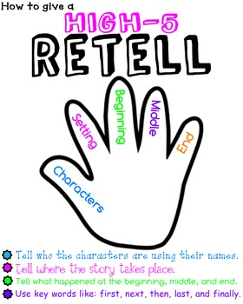
Retell
Retelling helps children recall what is happening in the story, develop a sense of story structure, and become more accurate in monitoring their understanding.
When children retell a story they tell or present it in a different way.
It is important your child can include the beginning, middle and the end of the story in their retell.
Retelling usually includes the characters, setting, problems, and solution or the main ideas of the book. It involves telling what is important in the story without telling too much.

Slide 17
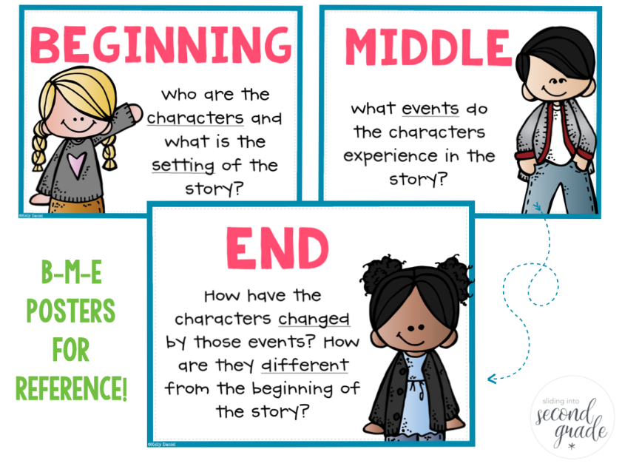
Retell
To help your child retell the story you can ask them to think about what you are reading. Stop and reread if they can’t remember.
One way to help them how to remember story sequence and character elements in the story is by using words such as first, next, then, last, and finally.

Slide 18



Making Connections
Text to Self Text to Text Text to World

Slide 19
Making Text to Self Connections
That reminds me of ………..
That makes me think of a time when ………..
I felt like ……… (character) when ……….
I know a person like this character ………
I would have felt differently from ………. because ……….
That part is similar to in my life because ………...
That is different from my life because ……….

Slide 20
Making Text to Text Connections
What does this remind me of in another book I’ve read?
How is this text similar to other things I’ve read?
How is this different from other books I’ve read?
Have I read about something like this before?

Slide 21
Text to World
What does this remind me of in the real world?
How is this text similar to things that happen in the real world?
How is this different from things that happen in the real world?
How did that part relate to the world around me?

Slide 22
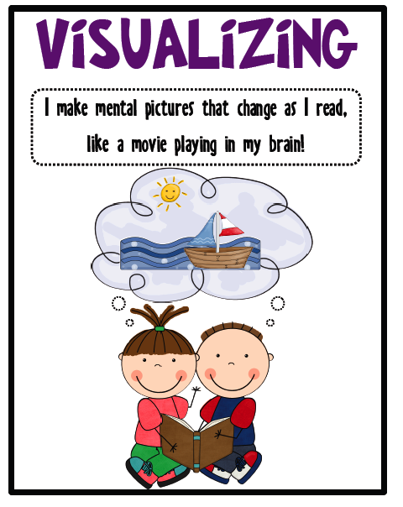
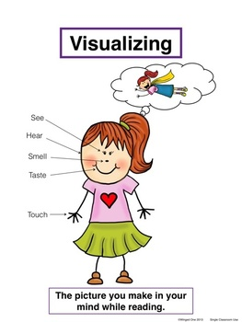

Visualising

Slide 23
Visualising is when your child can make a picture or movie in their head about what they are reading.
Visualising enhances your child’s comprehension about what they are reading.
You can help your child to visualise by doing the following:
Ask your child to close their eyes and think of a scene, character or event from the text. Put themselves in the context. Ask them:
What do you think is happening?
Why do you think this happened?
What do you think might happen next?
How does it make you feel?
How do you think the character is feeling?

Slide 24

Sign your child’s reading diary.
It is important that you sign
each night to show that you
have worked together.

Slide 25
WHAT IS VOCABULARY?
Vocabulary is all about words — the words in a language or a special set of words you are trying to learn.
Your vocabulary is the total number of words you know in a particular language. A rich vocabulary supports reading comprehension, learning about the world, encountering new ideas, enjoying the beauty of language.

Slide 26

Why is a rich vocabulary important?
Research shows that a rich vocabulary is critical for understanding what we read (reading comprehension).
Many studies have proven that a rich vocabulary is highly related to academic success.
 We have the opportunity and responsibility to increase our students’ word knowledge to enable them to become highly achieving learners.

Slide 27
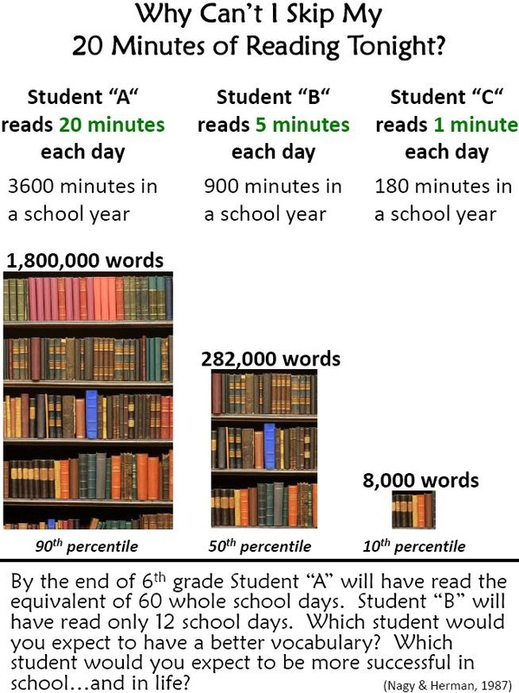

Slide 28
Which words make up a rich vocabulary?
Tier 1 Words:
Basic words: clock, baby, happy, walk
Tier 2 Words:
Words that occur quite often in written or spoken texts for mature language users across all topics and content areas: require, conceal, enthusiastic
Tier 3 Words:
Low-use, topic specific: ecosystem, condensation, friction, gravity, velocity, metamorphosis

Slide 29

How do we build children’s vocabularies?
Use mature words as part of your conversations. If a child can say Tyrannosaurus Rex they can say most anything!
Foster a love of words and their origins and meanings. Read books aloud to your child. Support your child to be on the lookout for interesting words in the story. Help them become a Word Wizard …

Slide 30

Year 2 Benchmarks
To be able to read at level 20
To recognize 307 Oxford Words

Slide 31

The time you spend with your child now, will make a huge difference to their confidence and their ability to learn for the rest of their lives.

Slide 32

Enjoy the
experience together!

