Slide 1
How to help your child learn to read

Slide 2
The 15 minutes you spend reading with your child will be the
most important 15 minutes of your day.

Slide 3
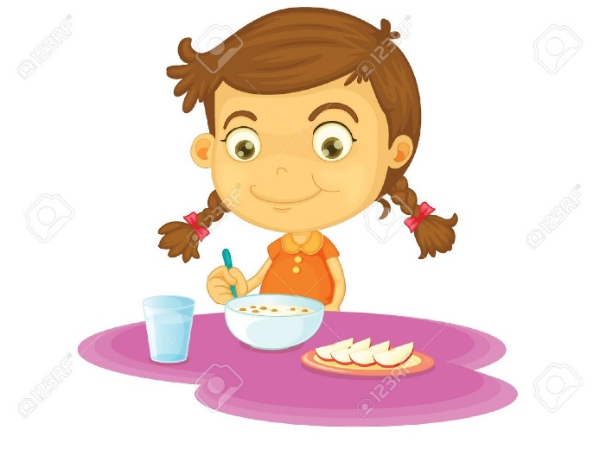
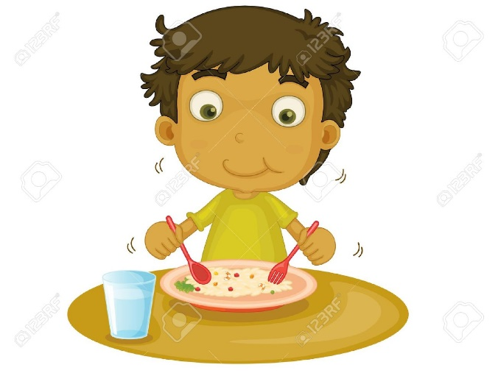
Start
homework after
your child has had a break.

Slide 4
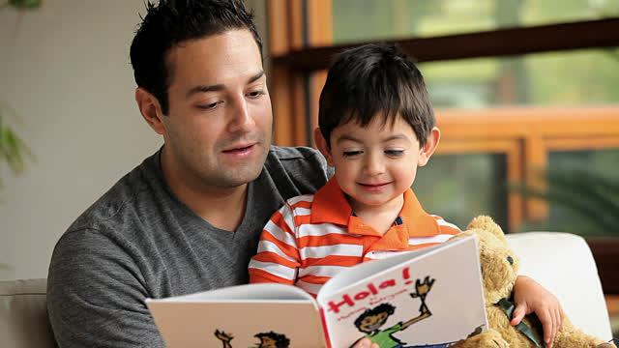
Make sure you can provide 10 - 15 minutes of uninterrupted time.

Slide 5
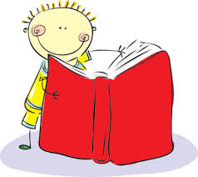
Start with their new book
This book has been introduced to your child that day.
Tricky words have been looked at with the teacher and the story has been discussed.

Slide 6
Listen to your child read the new book independently.
If your child comes across a tricky
word which they are not attempting
to work out independently,
don’t tell them the word.
Encourage them to use a reading strategy.

Slide 7
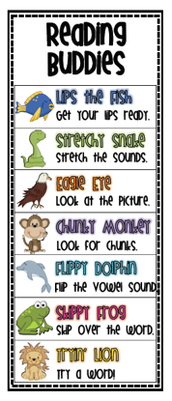
Reading Strategies
Strategies are things the children can
do to help them work out a word that
they do not recognize automatically.

Slide 15
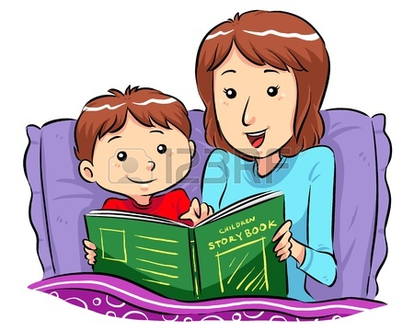
Discuss the book together
Try and make a connection with the book.
You might ask your child to remember a time when they had a similar experience.

Slide 16
Sign your child’s reading diary.
It is important that you sign
each night to show that you
have worked together.

Slide 17
Oxford Words
These words are extremely important when learning to read.
They have been put together after extensive research to find the words most frequently used by Australian students in their first three years of school.

Slide 18
Oxford Words
When your child can automatically recognise and read these words, they no longer need to use all their efforts to work them out.
They can now focus on understanding what is happening in the story.

Slide 19
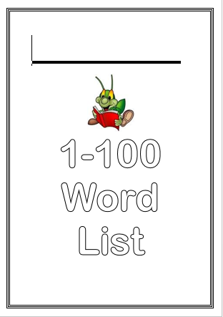
Oxford Words
Look at the next 5 Oxford
Words which your child is
learning and help them
to recognize, read and
remember them.

Slide 20
Oxford Words
Look at the tricky part of the word.
there

Slide 21
Oxford Words
Look for small words or chunks.
yesterday

Slide 22
Oxford Words
Get your child to write the 5 words on cards.
They can play lots of games they have learnt at school with the cards.

Slide 23
Oxford Words
Go back and constantly
revise known Oxford Words.
Automatic recognition is
the goal!

Slide 24
Year 1 Benchmarks
To be able to read at level 15
To recognize 307 Oxford Words

Slide 25
The time you spend with your child now, will make a huge difference to their confidence and their ability to learn for the rest of their lives.

Slide 26
Enjoy the
experience together!

